Slide 1
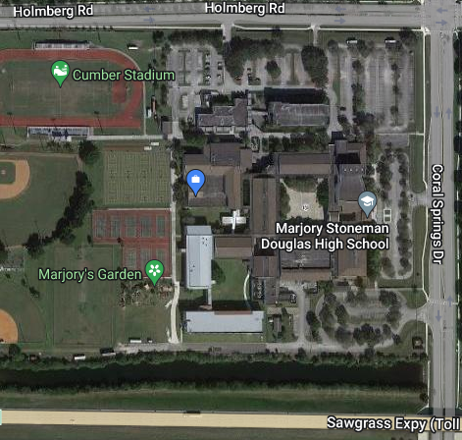
Judge Parking Zone
Do Not Park In Band Zone
Bikes
Bus Loop

